Slide 1
UCSD Embedded C Assignment 7
By
Hsuankai Chang
hsuankac@umich.edu

Slide 2
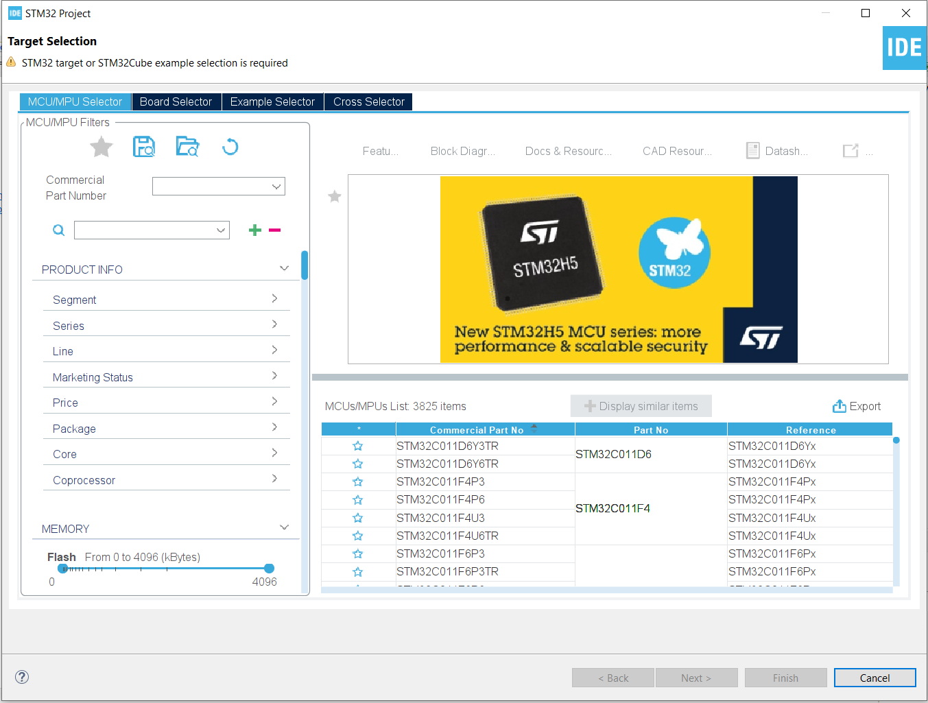
Step 1. Startup STM32CubeIDE and create new STM32 project

Slide 3
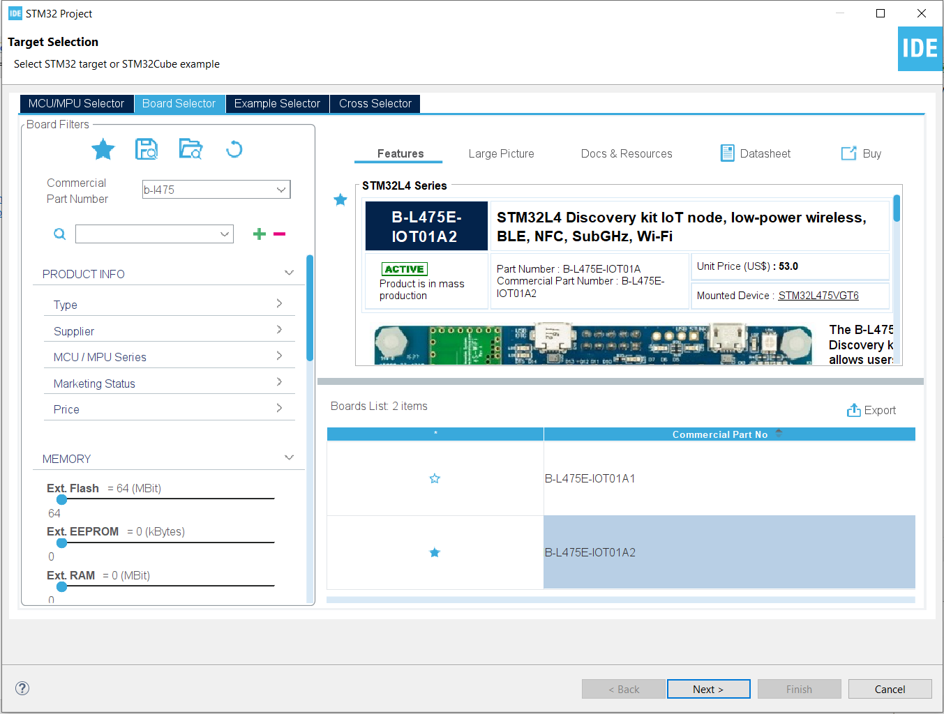
Step 2. Access board selector and type in the board you use, click Next

Slide 4
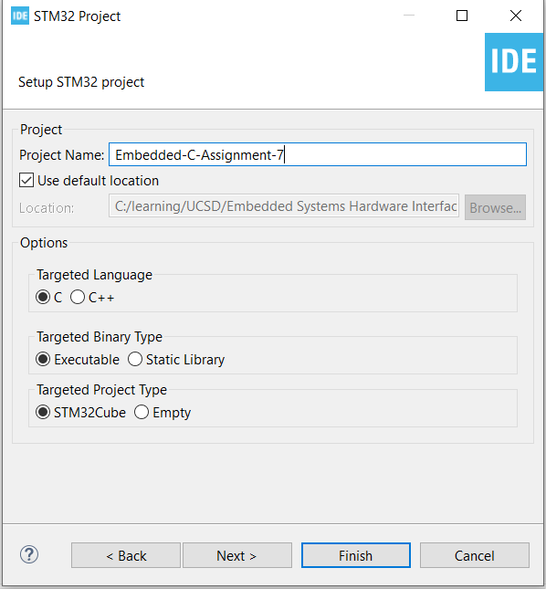
Step 3. Enter the project name then click Next

Slide 5
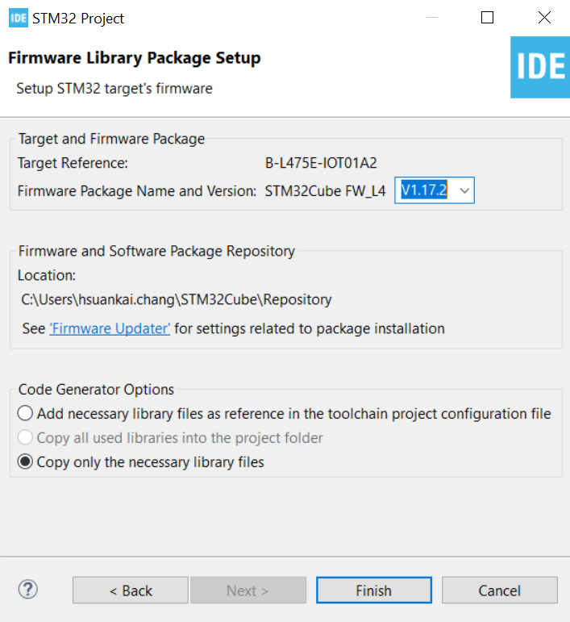
Step 4. See the firmware package name, version and location

Slide 6
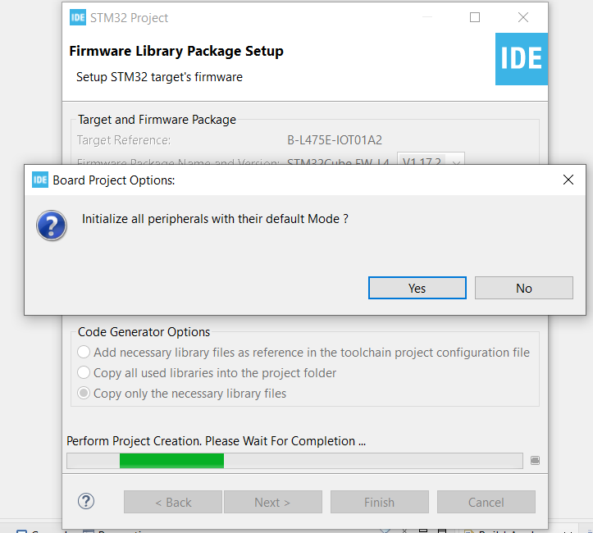
Step 5. Click yes to initialize all peripherals to default

Slide 7
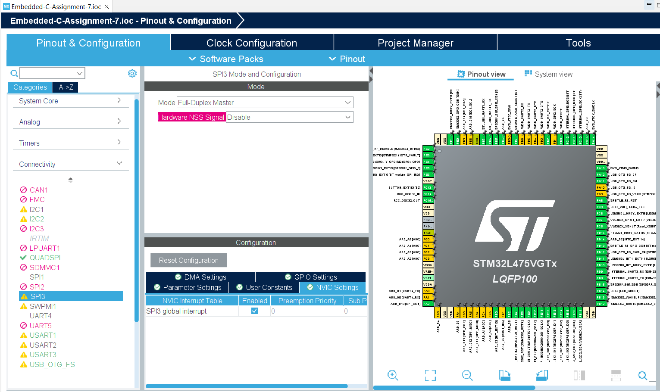
Step 6. When in .ioc file, remember to enable the SPI3 interrupt, otherwise we will get stuck in endless loop

Slide 8
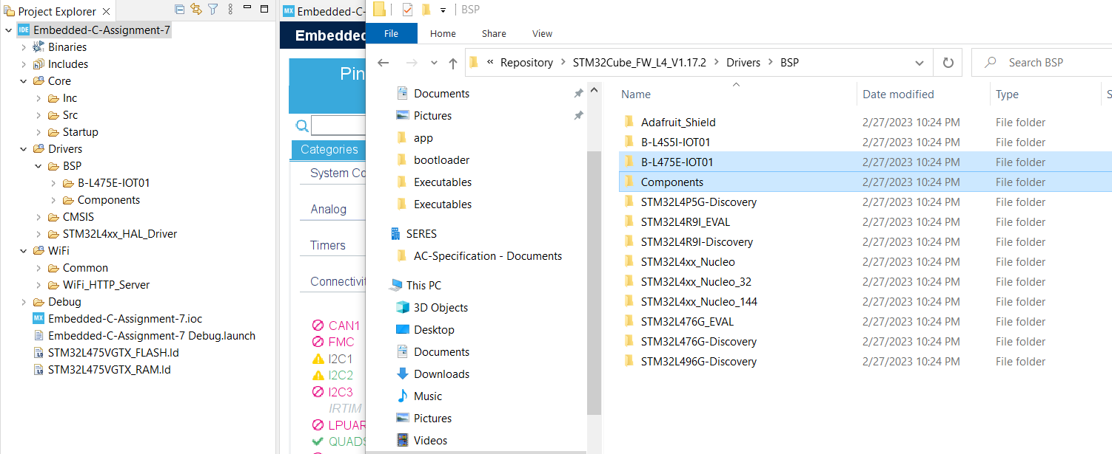
Step 7. Copy the necessary BSP folders into the project

Slide 9
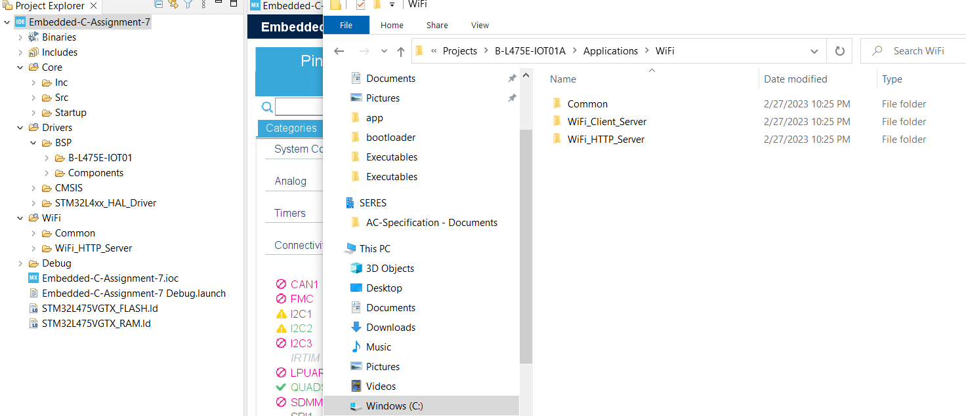
Step 8. Copy the WIFI project into the assignment project

Slide 10
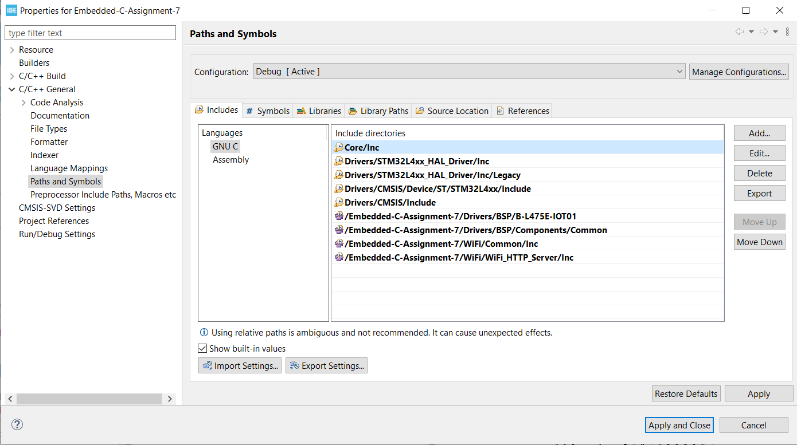
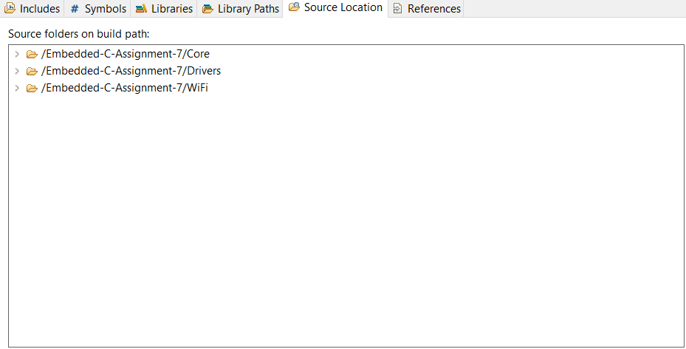
Step 9. Add the include path and the source path

Slide 11
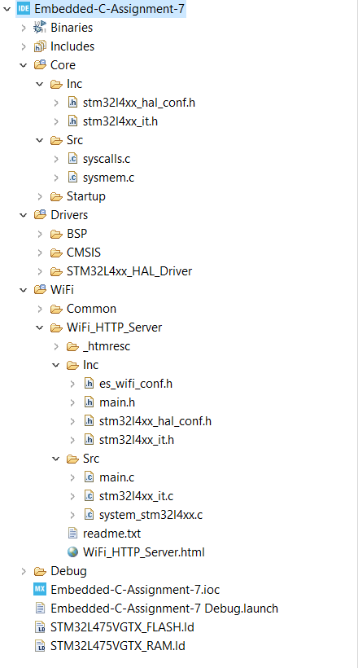
Step 10. Delete unnecessary files to make the compilation success

Slide 12
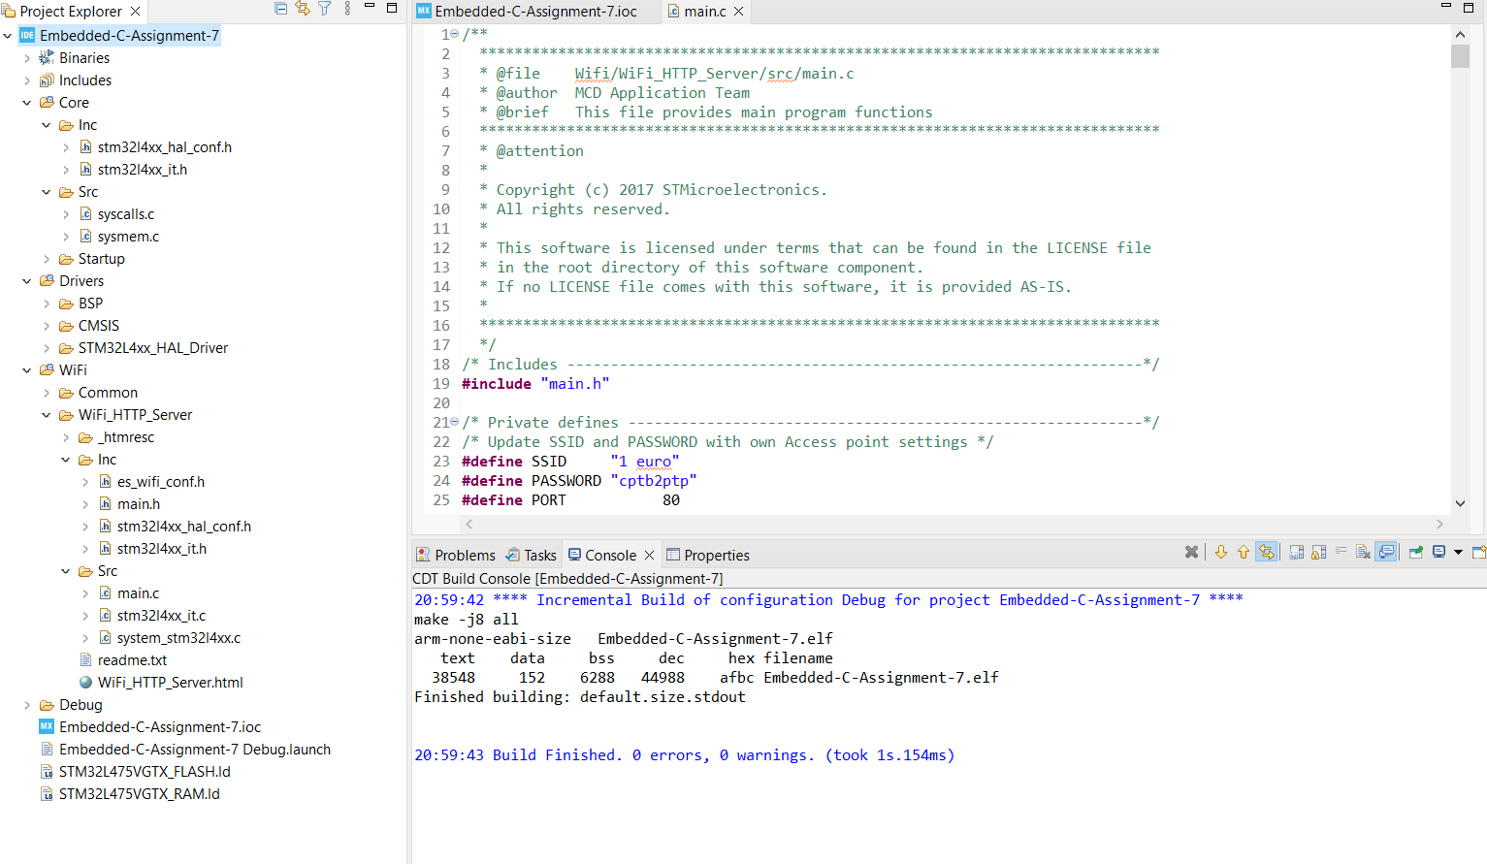
Step 11. Change the SSID and password to match your WIFI point, then compile and run the code

Slide 13
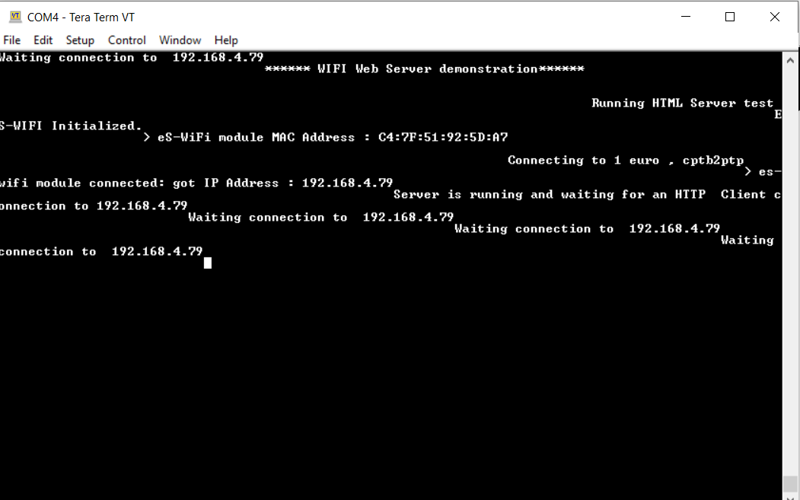
Step 12. Open the tera term and see the IP address

Slide 14
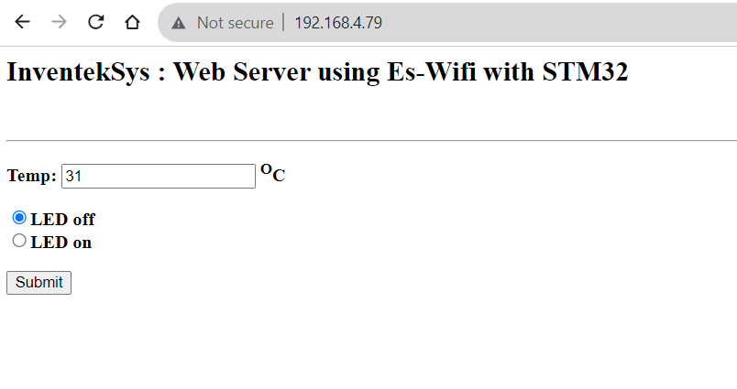
Step 13. Open the IP address and test the button functions, test is successful

Slide 15
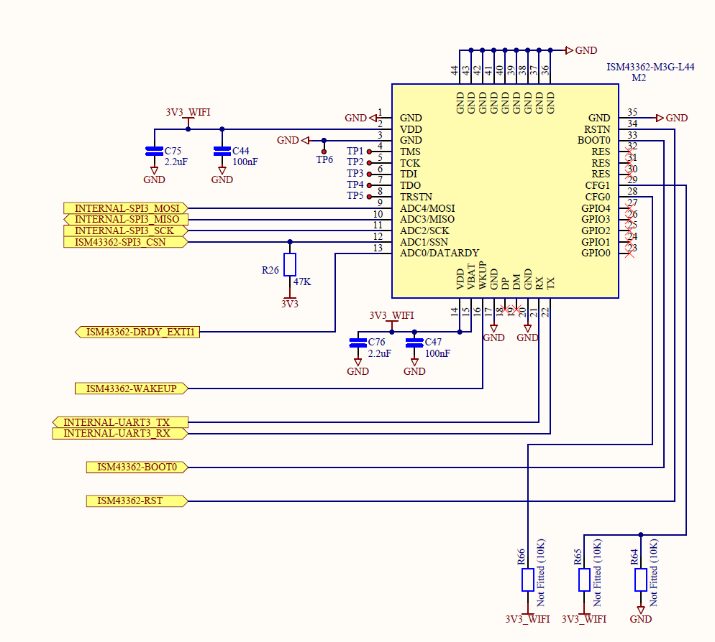
Appendix, schematic for WIFI module

Slide 16
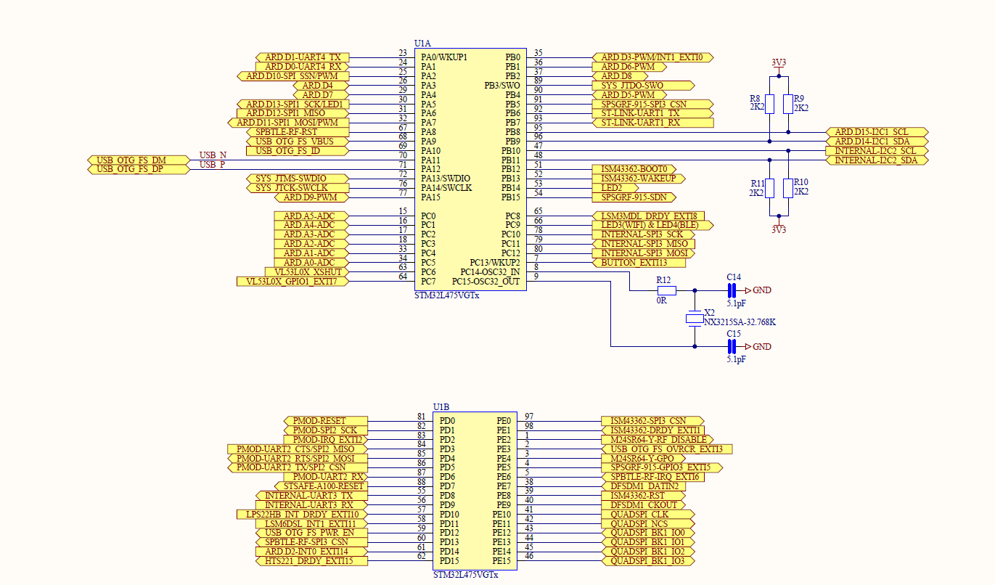
Appendix, schematic for WIFI module, processor side view

